Slide 1
Introduction to UNIX
CIS 200

Slide 2
INTRODUCTION TO UNIX OS
What is UNIX?
One type of computer operating system.
What is an operating system?
Operating system: control program of a computer
Functionality: allocate computer resource
- central processing unit (CPU)
- memory
- Peripheral

Slide 3
INTRODUCTION TO UNIX OS
How has it been evolved?
Status: Matured and widely used
History of Unix
Year | Version | Subject
1969 | The beginning | developed by Ken Thompson at AT&T Bell Lab in Murray Hill, New Jersey
1971 | First Edition | It had an assembler for PDP-11/20
1973 | Fourth Edition | It was rewritten in C by Dennis Ritchie. This made it portable and changed the history of OS’s

Slide 4
INTRODUCTION TO UNIX OS
History of Unix
1979 | Seventh Edition | It added Bourne shell and ported to VAX machine
1980 | Xenix | Microsoft introduced Xenix UC Berkeley released 4BSD (Berkeley Software Distribution)
1983 | System V | Unix System Development Lab and AT&T announced Unix system V, the first supported release
1984 | 4.2BSD | 4.2BSD which had TCP/IP (Transmission Control Protocols/Internet Protocl)
1989 | SVR4 | System V Release 4, unifying System V, BSD and Xenix

Slide 5
INTRODUCTION TO UNIX OS
History of Unix
Three variations are popular nowadays:
BSD, Berkeley Software Distribution
System V, descended from AT&T version
Linux, developed by Linus Torvalds
1991 | Linux | Linus Torvalds began Linux development with the assistance of developers around the world under the GNU General Public License
1993 | 4.4BSD | 4.4BSD the final release from Berkeley.June 16 Novell acquired USL
1999 | Linux 2.2 | Linux 2.2 kernel released

Slide 6
Reasons to study
Machine independent (written by C)
Open source without cost
Powerful scripting languages
Multi-tasking
Multi-user
Widely accepted

Slide 7
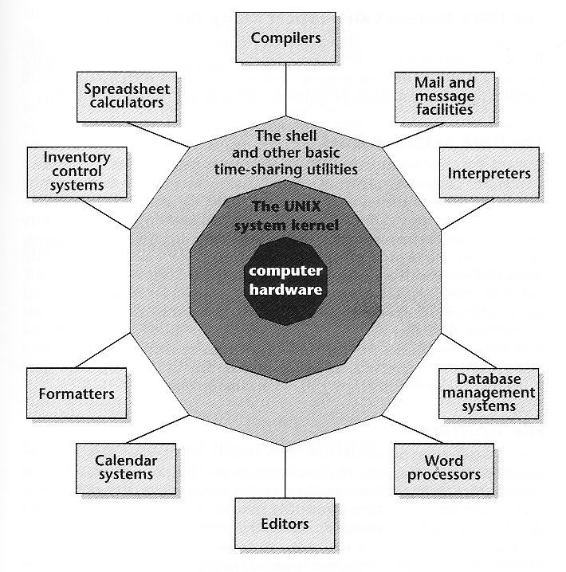
Structure of UNIX

Slide 8
Structure of UNIX
Unix System Kernel
- The heart of Unix system responsible for controlling computer resources and scheduling user jobs.
- Resources include CPU and peripheral devices.
- System calls: programs interact with kernel
Shell
- A command interpreter, an interface between users and OS
What is interpreter?
- A higher level language which uses system calls directly (compared to C)
- Three most famous shell scripting languages: Bourne, C and Korn

Slide 9
Structure of UNIX
Utilities
Commands – several hundred utility programs (sort and man)
Perform functions that are universally requested by users
Applications
Application programs like compiler, editor, spreadsheet, database management system.

Slide 10
Structure of UNIX
Main Objective: show how to begin using UNIX
Your UNIX account: Each user must have a UNIX account that includes a username and password. It is normally set up by a system administrator.
Make a connection: A login prompt from a UNIX host → a connection has been set up. If not, ask system administrator for help.
Prompts: When a computer is ready to listen to your directions, it displays a prompt ( $, % or >).
Commands: Commands are directions given to a computer. To give a computer a command, you type the command name and then press RETURN key.
Most UNIX commands allow you to attach one or more arguments, e.g. finger jim.

Slide 11
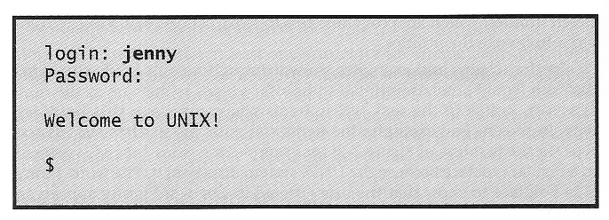
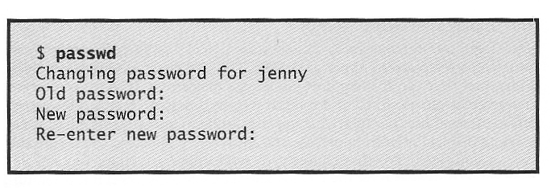
Structure of UNIX
UNIX is case-sensitive
Logging in
UNIX is case-sensitive
Change password
It must be at least six characters long
It must contain at least two letters and one number

Slide 12
Structure of UNIX
Logging out
Simply type logout
getting information
On traditional UNIX system, the UNIX reference manual is online (i.e., in the computer) and is called man pages. The man command can be used to retrieve descriptions of all the UNIX commands and some application programs.
$ man passwd → show the description of passwd command

Slide 13
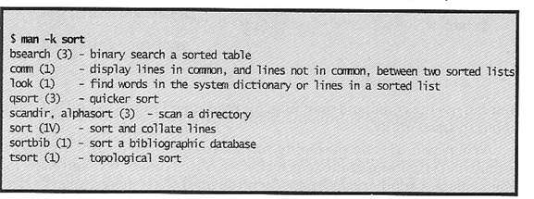
Structure of UNIX
If you do not know the name of the command, use a keyword to assist your search.
Output: A list of utility commands that you can use to sort a list of words.
Name of command
Section of manual
A brief description

Slide 14
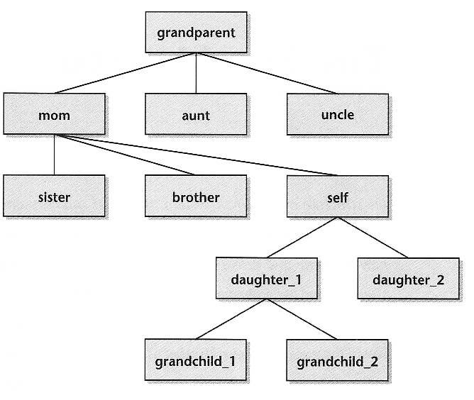
File Systems in UNIX OS
Hierarchical file structure
Unix file system is hierarchical, like a family tree
One difference between family tree
and Unix file structure:
directories
ordinary files

Slide 15
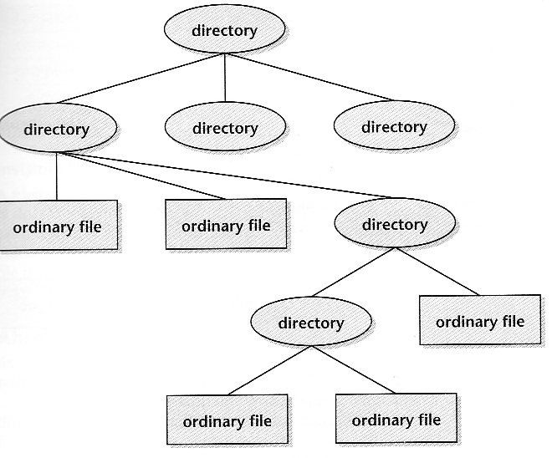
File Systems in UNIX OS
Hierarchical file structure
Directory is not the leaf and
contains one or more directories
or files, oval..
Ordinary files are leaves, rectangle

Slide 16
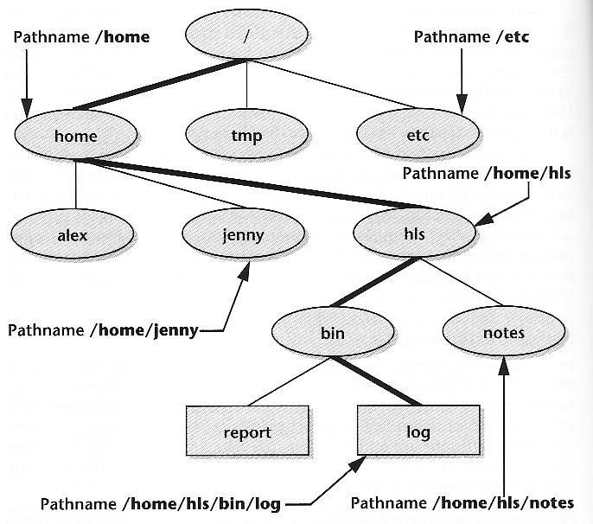
File Systems in UNIX OS
Root directory
It is the top directory in Unix
system, expressed by /.

Slide 17
File Systems in UNIX OS
Pathnames
Pathname refers to the location of a file in Unix system, i.e., in Unix
Pathname/file_name → to locate each file
Pathname - from left to right → top to bottom
example:
Absolute
Relative

Slide 18
File Systems in UNIX OS
Absolute pathnames
Absolute pathname refers to the location of a file with respect to the root directory. One example is
/home/hls/bin/log
The first / signifies the root directory
/home/hls/bin/ is absolute pathname

Slide 19
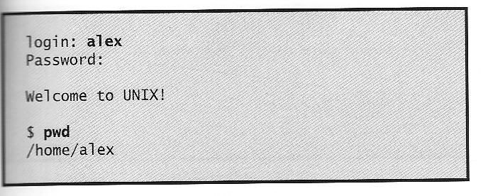
File Systems in UNIX OS
Current working directory
Whenever you are using a UNIX system, you are in a specific directory that is called the current working directory, signified by a period ., as a shorthand notation. Relative pathname is on basis of the current working directory.
How to find the current working directory ?

Slide 20
File Systems in UNIX OS
Relative pathnames
Relative pathname refers to the location of a file with respect to the current working directory.
e.g. if file log’s location in terms of absolute pathname is /home/hls/bin/log and its current working directory /home/hls, then the location of this file in terms of relative pathname is
./bin/log
The first . signifies the current working directory
./bin/ is relative pathname

Slide 21
File Systems in UNIX OS
Your home directory
When you first login to a UNIX system, you are in the directory that holds your personal files, known as your home directory.
Shorthand for your home directory: ~username or ~

Slide 22
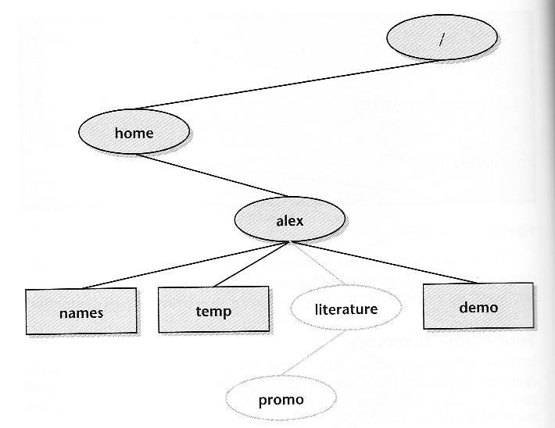
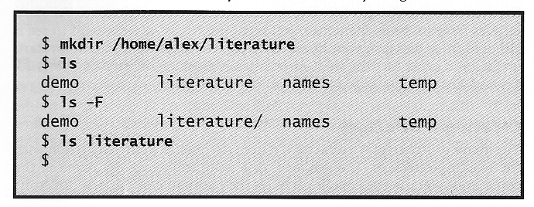
File Systems in UNIX OS
Create a directory
mkdir is the command to create
a directory
ls is a command to list all files/directories in the current directory
-F is an option to show the directories
with an appended /

Slide 23
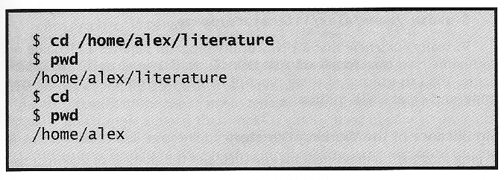
File Systems in UNIX OS
Changing to another directory
cd is a command to make another directory as the current working directory.
cd + absolute pathname/file_name
cd + relative pathname/file_name
cd → your home directory

Slide 24
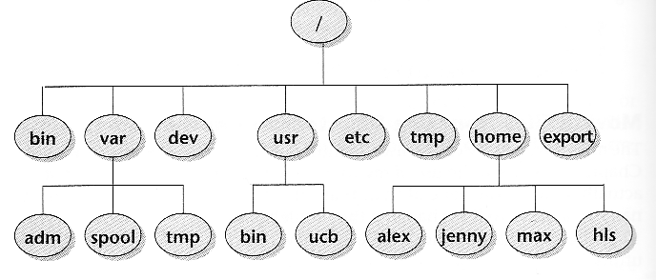
File Systems in UNIX OS
Important standard directories in UNIX
/ is ancestor of all files
/home contains each user’s home directory
/usr contains info used by the system
/bin or /usr/bin contains UNIX utility programs
/dev all files that represent peripheral devices
/etc, /usr/etc administrative, configuration, and other system files

Slide 25
File Systems in UNIX OS
File names
As many as 255 characters
No two files in the same directory share the same name
Invisible file name
File name starts with a period, like .login

Slide 26
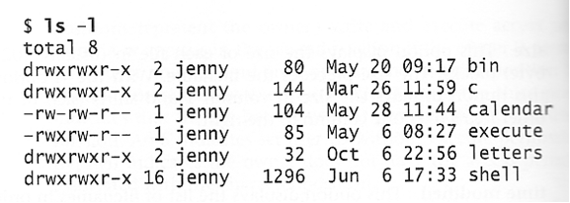
File Systems in UNIX OS
To see ordinary files and directories without invisible files,
-l is an option for ls to display in a long list
how to identify directories ?

Slide 27
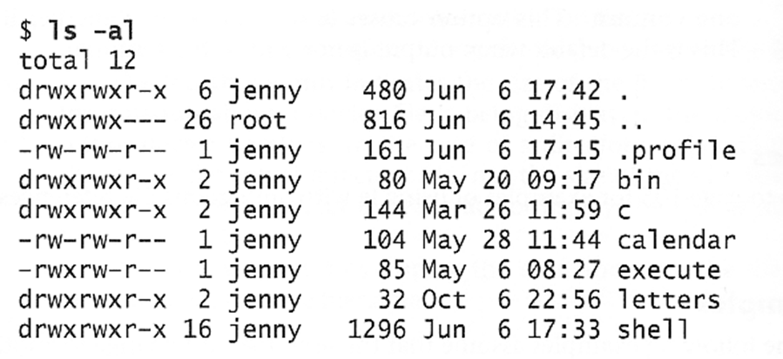
File Systems in UNIX OS
To see invisible files,
-a is an option to display everything

Slide 28
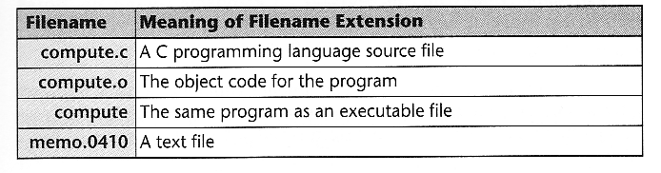
File Systems in UNIX OS
Filename extensions
A filename extension is the part of filename following an embedded period.
What are the filename extensions of C++ and Java files?

Slide 29
File Systems in UNIX OS
Access permissions of files
Unix allows you to specify access rights to each files with respect to three types users:
Owner: yourself
Group: people in the owner’s group
Others: everyone else
Each type of users have three rights to access this file
Read permission: If this permission is on, the user can read this file.
Write permission: If this permission is on, the user can modify this file.
Execution permission: If this permission is on, the use is allowed to execute this file.

Slide 30
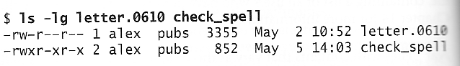
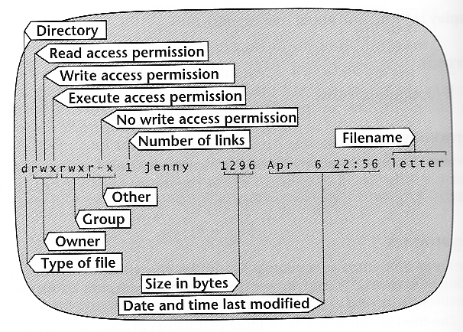
File Systems in UNIX OS
How to find access permissions of each file?
-l is an option to show a long list
-g is an option to display group name

Slide 31
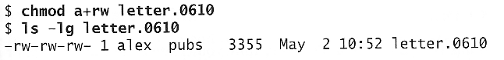
File Systems in UNIX OS
Changing access permissions
can a group member modify letter.0610 ?
can any user execute check_spell ?
To add access permissions,
a means for all users
+ means to add access permissions
compare the difference

Slide 32
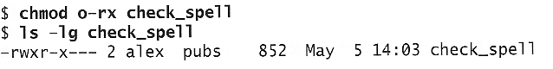
File Systems in UNIX OS
To remove access permissions,
o means for other users
- means to remove access permissions
compare the difference
can other users see check_spell?
chmod can also be used for changing the access permissions of directories in a similar way.

Slide 33
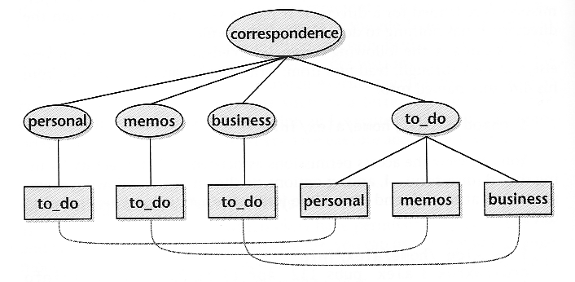
File Systems in UNIX OS
Links
A link is a pointer to another file.

Slide 34
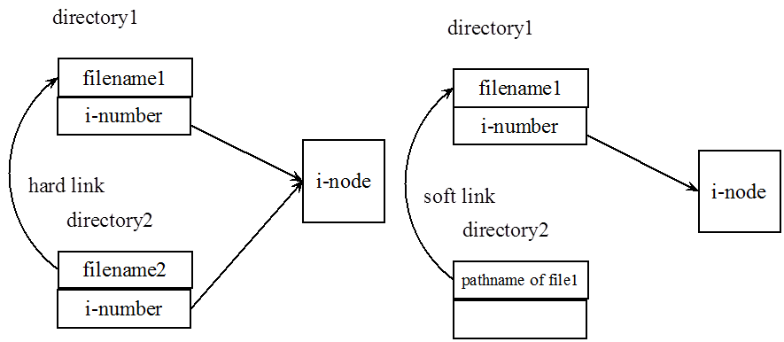
File Systems in UNIX OS
Type of links in Unix:
hard link: is a pointer to another file.
When a hard link is made, then the I-numbers of two directory file entries point to the same
i-node. (Remember that a directory is nothing more than a list of the names and I-number of files).
A hard link to a file is indistinguishable from the file itself.
Format: ln existing-file new-link

Slide 35
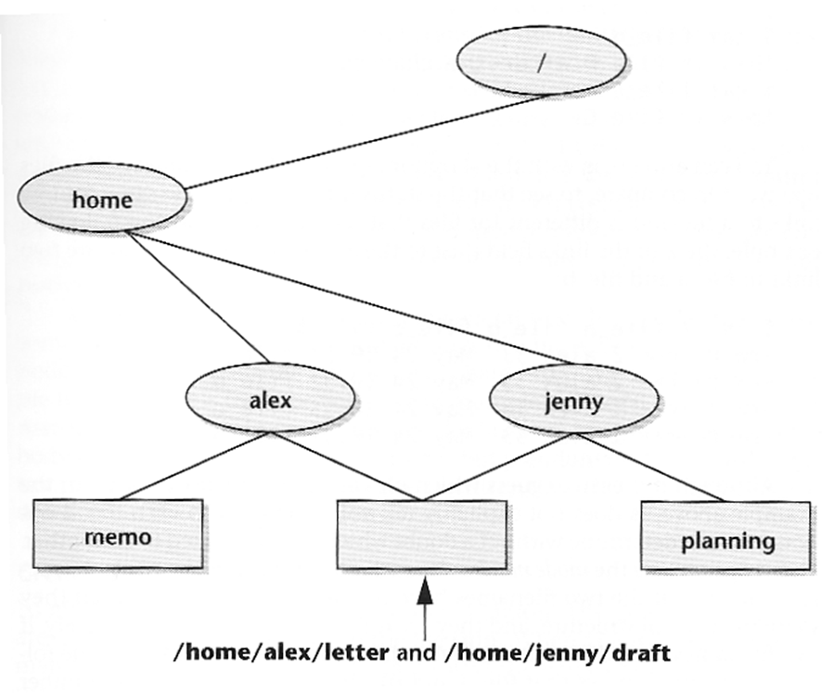
File Systems in UNIX OS
$ ln draft /home/alex/letter (current working directory = /home/jenny)
Advantage:
Available in all versions of UNIX
Disadvantage:
Can not span cross file systems
Can not connect directories

Slide 36
File Systems in UNIX OS
Soft link
The second type of links to overcome hard link’s shortcoming.
A soft link (symbolic link) is an indirect pointer to a file.
A soft link is implemented as a directory file entry containing a pathname.
Soft links are distinguishable from source files.
Format: ln -s existing-file new-link
$ ln -s draft /home/alex/letter (current working directory = /home/jenny)

Slide 37
File Systems in UNIX OS
Soft link
Advantage:
Can span cross file systems
Can connect directories
Disadvantage:
Not all versions of UNIX supports soft links
Not valid if file gets deleted

Slide 38
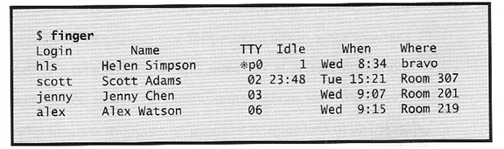
Major Commands in UNIX OS
Finger
A command to display information about a certain person or a list of people who are currently using the system.
TTY - name of terminal
Idle - idle time
When - login time
Where - user’s location

Slide 39
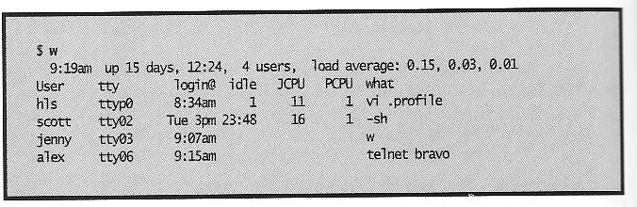
Major Commands in UNIX OS
W: A command to show who and what all logged-in users are doing.

Slide 40
Major Commands in UNIX OS
Output:
The first line provides a lot of info about the system: Current time of day, running time (days, hours, minutes), how many users and load average of system
System load averages for the last minute, five minutes, and fifteen minutes. Load, in this case, is the average length of the process queue.
What is the process queue?
The length of process queue represents the workload of the system at that time
If the first one > 0.5, there may be some problem in system.
The remainder of w's output pertains to each person logged in

Slide 41
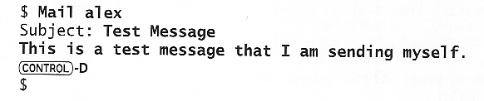
Major Commands in UNIX OS
User
USER: Their UNIX login, or the first eight characters of it anyway TTY: How they are connected, terminal name LOGIN@: When they logged in, hour and minute, or which day if they've been connected that long IDLE: How long it's been since they typed anything JCPU: The amount of CPU time consumed by all their active processes PCPU: The amount of CPU time consumed by the current process WHAT: Name of the current process.
Mail
you can use this command to send and receive an email
- alex is a user name
- Ctl+D to signify the end of the message.

Slide 42
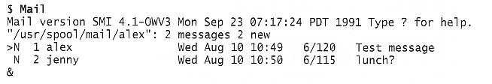
Major Commands in UNIX OS
To check your emails,
> refers to the current message
& is the prompt of mail command
N means new message
Number of lines/number of characters

Slide 43
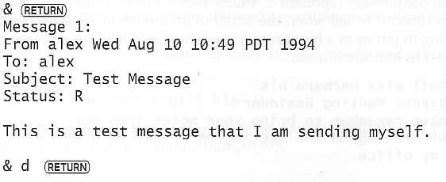
Major Commands in UNIX OS
To read and delete a message,

Slide 44
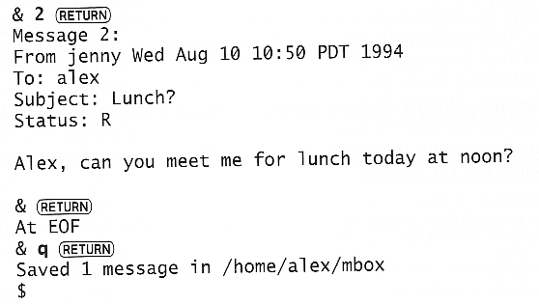
Major Commands in UNIX OS
To view the second message
2 means to read the second message
q means to quit

Slide 45

Major Commands in UNIX OS
To email somebody outside the LAN: $ Mail jim@hotmail.com
echo
This command is to display text on the terminal.

Slide 46
Major Commands in UNIX OS
CP: This command is to make a copy of a file.
$ cp source-file target-file
source-file should exist
target-file should have a different file name.
MV: This command is to change the name of a file.
$ mv existing-file new-file
new-file should have a different file name
IPR: This command is to print a file.
$ lpr report → print on the default printer
$ lpr –Phplj report → print on printer named Phplj

Slide 47
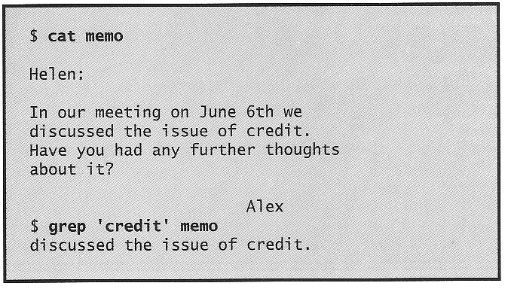
Major Commands in UNIX OS
Cat: This command is to display a file.
$ cat report → display the content of report
Grep: (global regular expression print) utility is used to find a string in a file.
grep does not modify the content of the file memo
only displays each line containing the string ‘credit’
should use single quote for the string

Slide 48
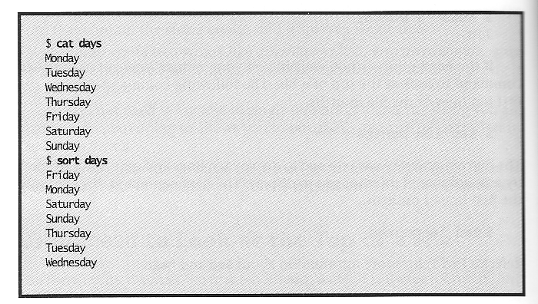
Major Commands in UNIX OS
sort
This command is to display the contents of a file in order by line.

Slide 49
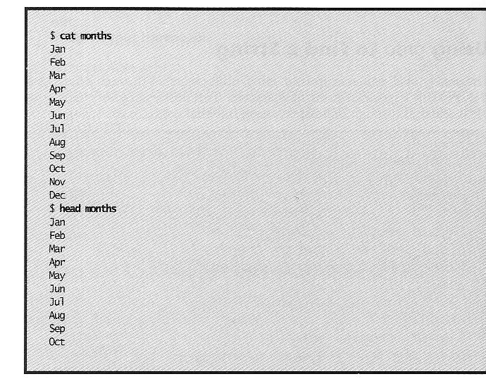
Major Commands in UNIX OS
head
This command is to display the first ten lines of a file.
Useful to remind you what is inside the file
head –1 months

Slide 50
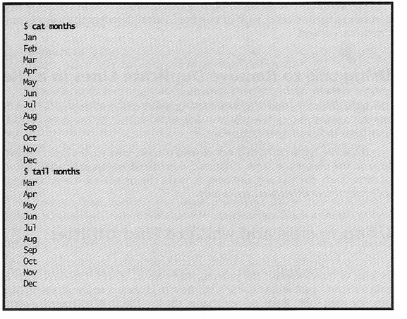
Major Commands in UNIX OS
Tail
This command is to display the last ten lines of a file.
tail –n months

Slide 51
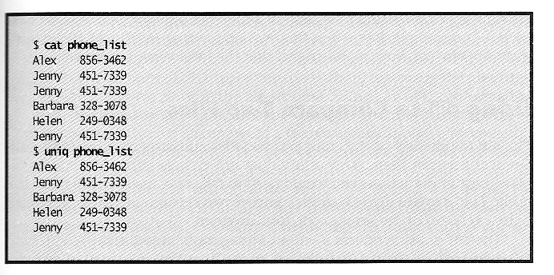
Major Commands in UNIX OS
Uniq: This command is to display a file by skipping adjacent duplicate lines.

Slide 52
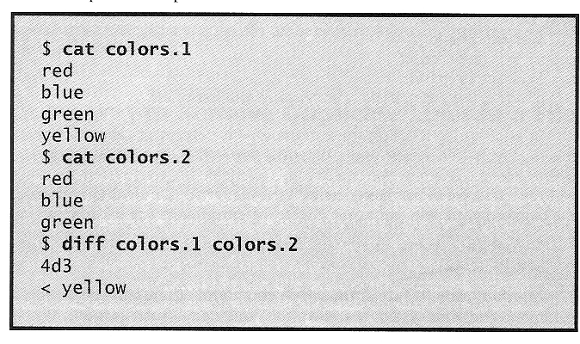
Major Commands in UNIX OS
Diff: This command is to compare two files and to display a list of differences.
Less than sign → line from the first file
Greater than sign → line from the second file

Slide 53
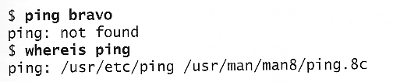
Major Commands in UNIX OS
Find utilites
Two useful commands in UNIX: whereis and which.
whereis is to find the location of a command which may not be found in your current setting.
which is to find the location of a version of a command which is being used in your current setting.
$ which cat
/bin/cat ← there may be several versions of cat installed on the system
Can you tell the difference between whereis and which now ?

Slide 54
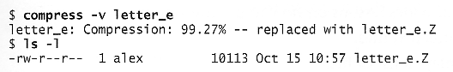
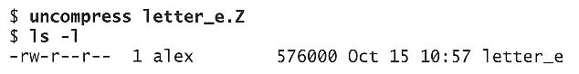
Major Commands in UNIX OS
zip and unzip file
You can use compress and uncompress to zip and unzip a file, respectively.
v - an option that means verbose

